Slide 1



Earthquake Project_RISHABH_CHHILLAR
View in Power BI
Last data refresh:
7/7/2022 9:47:33 AM UTC
Downloaded at:
9/17/2022 11:57:32 AM UTC

Slide 2
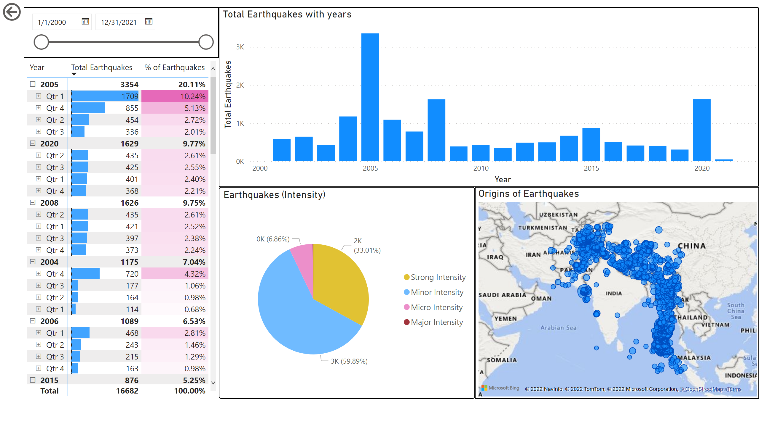
Earthquake data
Notes:
pivotTable
No alt text provided
Total Earthquakes with years
No alt text provided
actionButton
No alt text provided
slicer
No alt text provided
Earthquakes (Intensity)
No alt text provided
Origins of Earthquakes
No alt text provided

Slide 3
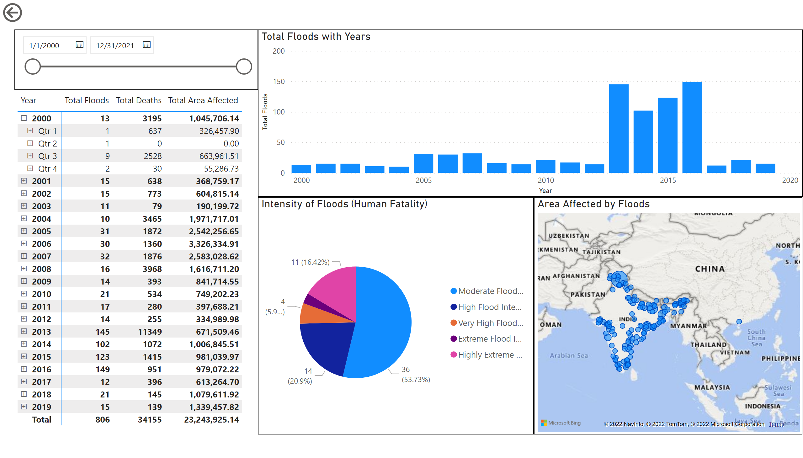
Floods data
Notes:
actionButton
No alt text provided
slicer
No alt text provided
Total Floods with Years
No alt text provided
Intensity of Floods (Human Fatality)
No alt text provided
pivotTable
No alt text provided
Area Affected by Floods
No alt text provided

